Slide 1
Dependent drop-downs
October 17, 2014
Notes:
Guidewire training materials contain Guidewire proprietary information that is subject to confidentiality and non-disclosure agreements. You agree to use the information in this manual solely for the purpose of training to implement Guidewire software solutions. You also agree not to disclose the information in this manual to third parties or copy this manual without prior written consent from Guidewire. Guidewire training may be given only by Guidewire employees or certified Guidewire partners under the appropriate agreement with Guidewire.

Slide 2
Describe the behavior of dependent drop-down lists
Distinguish between a typefilter and keyfilter
Differentiate between a category filter and a categorylist filter
Recall the data model configurations required for creating dependent drop-down lists

Slide 3
Typefilter review
Dependent drop-down lists and keyfilters
Configuring dependent drop-down lists

Slide 4
Typekey fields
A typekey field is an entity defined field associated with a specific typelist
Referenced typelist contains typecodes whose values are the only possible value for the typekey field
BuildingType_Ext Residential - single Residential - multi Office Industrial Hotel Other
Notes:
When discussing typekey fields for a typelist, the term "typelist" refers to both a TTI file and a TTX and the term entity refers to both ETI and ETX files.

Slide 5
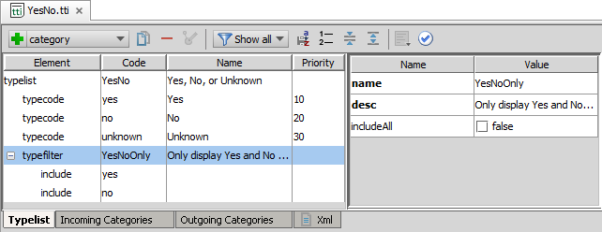
Static typelist filters: typefilter
A static typelist filter defines a subset of typecodes in the typelist
Configure the typefilter for typelists to filter available typecodes
Example: YesNoOnly typefilter
Notes:
You define a static filter at the level of the typelist. A static typelist filter causes the typelist to display only a subset of the typecodes for that typelist. A static filter narrows the list of typecodes to show in the user interface of the Guidewire application.
In the slide example, the YesNoOnly typelist filter is a typefilter element and contains two include filters: yes and no. An alternative to this configuration is to create a typefilter that contains an exclude filter for the unknown typecode.

Slide 6
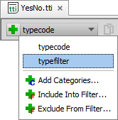
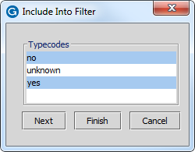
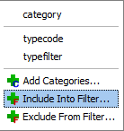
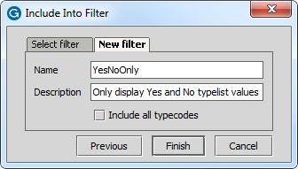
Create a typefilter
Add typefilter element
Enter name
Add Include Into Filter typecodes
Select typecodes
Select New Filter and enter new name
Notes:
You define a typefilter at the level of the typelist. Use the Typelist Editor to manually define a filter for a particular typelist.

Slide 7
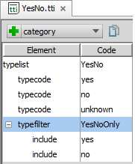
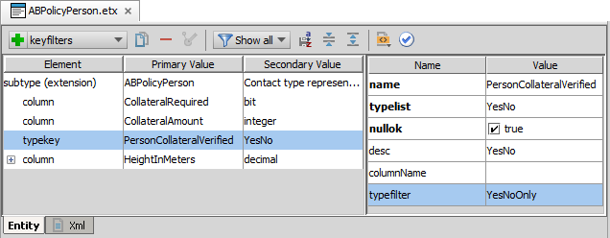
Entity configuration for typefilter
For the typekey element in the entity file, specify the typefilter attribute
Only values in the typefilter are specified (included or excluded)

Slide 8
Typefilter review
Dependent drop-down lists and keyfilters
Configuring dependent drop-down lists

Slide 9
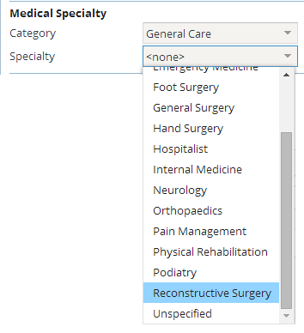
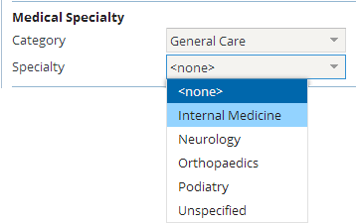
Dependent drop-down list behavior
Independent drop-down lists have no parent-child association
All values available
Dependent drop-down lists associate parent and child
Parent selection dynamically filters child list values
Example:
Category is parent
Specialty is child

Slide 10
Various typelist filters
Static filter: typefilter
Dynamic filter: category
Dynamic filter: categorylist
Create at typelist level
Include or exclude elements defined using typecodes in typelist
Entity configuration specifies typefilter for typekey
Add category filter at child typelist level
Child typelist typecode(s) associated with parent typelist typecode(s)
Typelist editor shows incoming and outgoing categories
Entity configuration specifies keyfilters for typekey
Add categorylist filter at child typelist level
Child typelist typecode associated with all parent typelist typecodes
Entity configuration specifies keyfilters for typekey
Notes:
By their very nature, typelists are static and the values displayed in the user interface reflect the static typecode values. In this sense, the terms static filter and dynamic filter are somewhat misleading. The term "dynamic" better reflects the behavior in the user interface for the related typekey input widgets that create the dependent drop-down lists.
The configuration of the given typelist(s) filter(s), the related entity typekey keyfilter configuration, and the related PCF configuration(s) determine the display behavior of dependent drop-down lists.

Slide 11
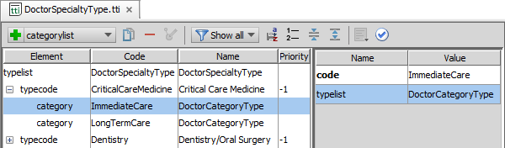
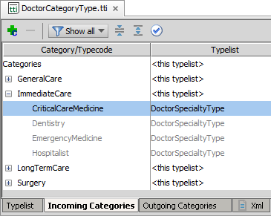
Category filter
A category filter associates one or more typecodes on a parent typelist with one or more typecodes on a child typelist
Incoming Categories tab in parent typelist shows child typecodes
Notes:
In the slide example, the configuration of the DoctorCategoryType category filter for the CriticalCareMedicine typecode in the DoctorSpecialtyType typelist associates the ImmediateCare and LongTermCare typecodes with the CriticalCareMedicine typecode. As the Incoming Categories tab in the DoctorCategoryType typelist illustrates, the ImmediateCare typecode shows the CriticalCareMedicine typecode as a child association.
The child typelist shows the parent typelist typecode as a category. The child typelist shows categories for each typecode and the typecode can be in multiple categories. The child typelist shows outgoing categories.
The parent typelist shows the categories derived from its typecodes and the child typelist typecodes. The parent typelist shows incoming categories.

Slide 12
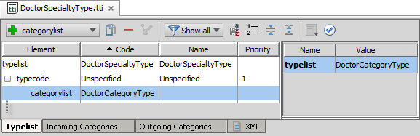
Categorylist filter
A categorylist filter Associate all the typecodes on a parent typelist with one or more typecodes on a child typelist
Example:
Unspecified typecode is associated with all typecodes in the parent typelist
Notes:
In the slide example, the configuration of the DoctorCategoryType categorylist for the Unspecified typecode in the DoctorSpecialtyType typelist associates all the typecodes in the DoctorCategoryType typelist with the Unspecified typecode.

Slide 13
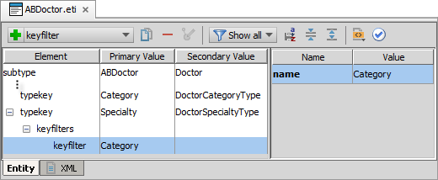
Entity typekey keyfilters
Keyfilter specifies the parent typekey that filters the child typekey values
Typelist configurations for filters determine the typekey values
Notes:
In the slide example, the Specialty typekey is filtered by the Category typekey. The configuration of the child typelist (DoctorSpecialtyType) determines how the typecode are filtered by the parent typelist (DoctorCategoryType).

Slide 14
Typefilter review
Dependent drop-down lists and keyfilters
Configuring dependent drop-down lists

Slide 15
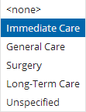
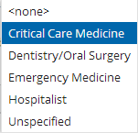
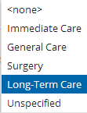
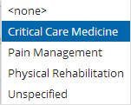
Dependent drop-down list configuration Example
Category
Specialty
Typekey keyfilters specify the dependency relationship
Typelist category and categorylist filters specify the filtering
Example
Doctor Category filters Doctor Specialty
Parent filters can share children typecode
Category
Specialty
Notes:
In the slide example, the ABDoctor entity specifies that the Specialty typekey has a keyfilter that is the Category typekey. Determining the typecode values in the user interface is the configuration of typecode category filters and categorylist filter in the DoctorSpecialtyType typelist.
The PCF configuration for the PCF input widgets requires no extra configuration. The Guidewire application user interface automatically creates the dependency between the drop-down lists. The term dependent drop-down lists describe this kind of typelist configuration.
By their very nature, typelists are static and the values displayed in the user interface reflect the static typecode values. The term dynamic drop-down lists describe a PCF configuration for an input widget that displays a collection of values, often returned by code, in a drop-down list.

Slide 16
Step 1: Create dependent drop-down lists
Add category filter and/or categorylist filter to child typelist
Configure typekey keyfilter
Add input widgets to PCF
Deploy your changes

Slide 17
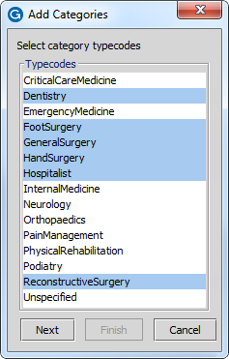
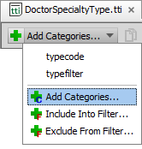
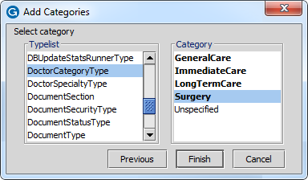
Step 1: Add a category filter
Open child typelist
In editor menu bar, select Add categories…
Select category typecodes
Select parent typelist
Select typecode category
Click Finish
Notes:
You define a typelist category filter on the child typelist. It is possible to have only a category filter for a child typelist.

Slide 18
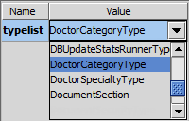
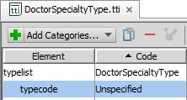
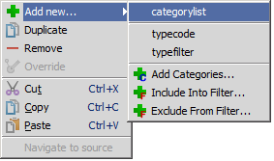
Step 1: Add a categorylist filter
Open child typelist
Select typecode in child typelist
Open context menu
Select Add new…
Select categorylist
Select parent typelist in attribute pane
Notes:
You define a typelist categorylist filter on the child typelist. It is possible to have only a categorylist filter for a child typelist. However, there usually is a default typecode that all parent typecodes will want as a filtered selection in a dependent drop-down list. For this reason, you often see a categorylist filter defined for the default child typecode that all parent typecodes require.

Slide 19
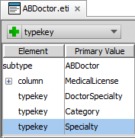
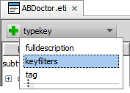
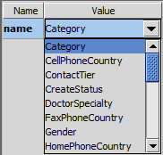
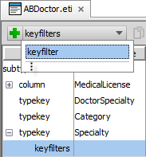
Step 2: Configure entity typekey keyfilter
Open the entity
Select the typekey for the child typelist
In editor menu bar, select keyfilters, then select keyfilter
Select parent typekey in attribute pane
Notes:
You can have more than one keyfilter for a given typekey keyfilters element. The keyfilter is the parent typekey defined in the entity that filters the selected child typekey.

Slide 20
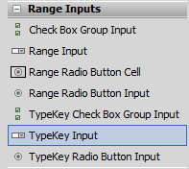
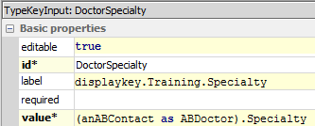
Step 3: Add TypeKey input widgets
Use TypeKey Input
Renders drop-down list
Has more configurable properties and better performing than input widget
Automatically configures behavior for dependent drop-down lists
Configure widget properties
editable, id, label, value, visible
Widgets for dependent drop-down lists need to render in the same screen
Widget do NOT need to be in the same PCF file
Notes:
It may seem negligible, but to resolve the underlying data type for the widget value takes extra application processing. In aggregate, widget resolution can be a performance issue. Wherever possible, use the input widget that best matches the needs of the user, widget special properties, and the underlying data type value.
For typekeys, the TypeKey Input widget is the best choice. You can also use the input widget. However, TrainingApp versions before 8.0.2 use the input widget rather than the TypeKey input widget for the DoctorCategory and DoctorSpecialty fields.
In most cases, the input widgets for dependent drop-down lists will exist in the same PCF file. However, you do not need to add input widgets for dependent drop-down lists to the same PCF file. The widgets only need to be rendered in the same screen at runtime. Client-side JavaScript manages the interaction between dependent drop-down lists and no server requests are made.

Slide 21
Step 4: Deploy your changes
Restart Server
Reload PCFs
Entity
Typelist
Also PCFs and Display Keys
ALT+SHIFT+L
Internal debug tools enabled
Internal Tools
Reload → Reload PCF Files
Entity
Typelist
Page Configuration File
Display Properties
Notes:
You can restart the server using the bin command window and entering, gwXX dev-stop and the gwXX dev-start, where XX stands for the two letter application code (AB, CC, PC). Or, from Guidewire Studio, stop the 'Server' process with Run → Stop ,and then start the process again with either Run 'Server' or Debug 'Server'.
In Studio, the newly created or modified typelist is available to reference immediately. However, the typelist is not available to the application server until the server is restarted.
In Studio, the newly created or modified entity is available to reference immediately. However, the entity is not available to the application server until the server is restarted and the database upgraded. The automatic database upgrade process occurs only if the database autoupgrade=true attribute is defined in the database-config.xml.
It is also possible to reload PCF files using the Guidewire API and/or internal server tools. The Reload PCF command can be found on the Reload page in Internal Tools. To access Internal Tools, the EnableInternalDebugTools setting in the config.xml file must be set to true. The keystroke to open the Internal Tools page is ALT+SHIFT+T. In the tab bar, select Internal Tools --> Reload. On the Reload page, click the Reload PCF Files button. Both the keystroke ALT+SHIFT+L and the Reload PCF Files button call the same static method: gw.api.tools.InternalToolsUtil.reloadPCFs().

Slide 22
Describe the behavior of dependent drop-down lists
Distinguish between a typefilter and keyfilter
Differentiate between a category filter and a categorylist filter
Recall the data model configurations required for creating dependent drop-down lists

Slide 23
What is the difference between a category filter and a categorylist filter?
What is the difference between a typefilter and a keyfilter?
What PCF configurations are required for dependent drop-down lists?
Notes:
Answers
1) You define both a category filter and categorylist filter on a child typelist. A category filter associates one or more typecodes on a parent typelist with one or more typecodes on a child typelist. A categorylist filter associates all the typecodes on a parent typelist with one or more typecodes on the child typelist.
2) You define a typefilter in a typelist. A typefilter specifies a static (fixed) set of typecode values from the typelist itself. The typecodes can be included or excluded from a typefilter. An entity that contains a typekey for a typelist with a typefilter can reference the typefilter by name in the typefilter attribute. You define a keyfilter for a specific typekey in an entity. The keyfilter specifies the parent typekey in the same entity definition that filters the child typekey values. The configuration of the child typelist determines how the typecodes are filtered by the parent typelist.
3) The dependent drop-down lists must use either the TypeKey Input or the Input widgets in the PCF. The widgets do not need to be in the same PCF file, but do need to be rendered in the same screen at runtime.

